Slide 1



COST Projeleri ve Uluslararası İşbirlikleri
Prof. Dr. Mustafa ERSOZ
Selcuk University, Faculty of Science, Department of Chemistry
Director of S.U. Advanced Technology Research Center
Konya, TURKEY
mersoz@selcuk.edu.tr
ersozm@gmail.com

Slide 2
Avrupalı araştırmacılar arasında etkileşim ve işbirliğini desteklemek amacıyla 1971 yılında kurulmuştur. 35 üye ülke, Ülkemiz kurucu üyeler arasındadır.
Bilimsel işbirlikte en uzun, devam eden, ERA oluşturan program
EU & ötesi, (H2020 ‘Cooperation’); uluslar arası organizasyonlar ve Ar-Ge Merkezleri, non-COST Countries (i.e. USA, Russia, Australia, New Zealand, India…)
"COST Actions“ (=projects), 340 devam eden COST Actions, süre 4 yıl, her yıl ortalama 80 yeni aksiyon
COST, ulusal olarak desteklenen araştırma projelerinin yürütücülerinin, Avrupa düzeyinde oluşturulmuş bilimsel ağlara dahil olmalarını sağlamaktadır.
COST’un ülkemizdeki bilimsel koordinatörlüğü TÜBİTAK tarafından sağlanmaktadır.

Slide 3


Slide 4
Araştırmacılar için Niçin COST?
Yeni, Yenilikçi ve disiplinler arası bilimsel işbirliği ağları
Bütün araştırmacılara (Bottom-up) açık, esnek
COST ve non-COST ülkeleri arasında bilimsel işbirliği
COST aksiyonlarına 45,000 Araştırmacının katılımı
Ülke fonları tarafından kendi kendini finanse etme
İşbirliği ağı içerisinde Araştırma için katma değeri
~2 milyar € /yıllık
COST AB Araştırma Alanı (ERA) ve Stratejik öncelikli konularını oluşturma
COST çalışmaları AB (HORIZON) programlarına dönüşmekte ve temel altyapısını oluşturma

Slide 5
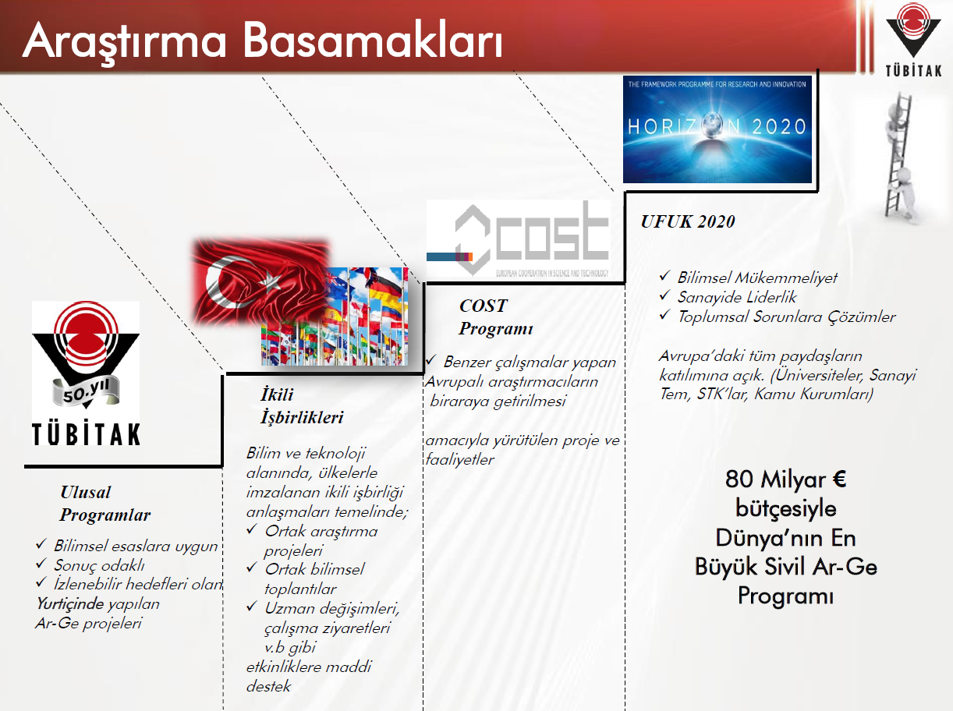



Slide 6
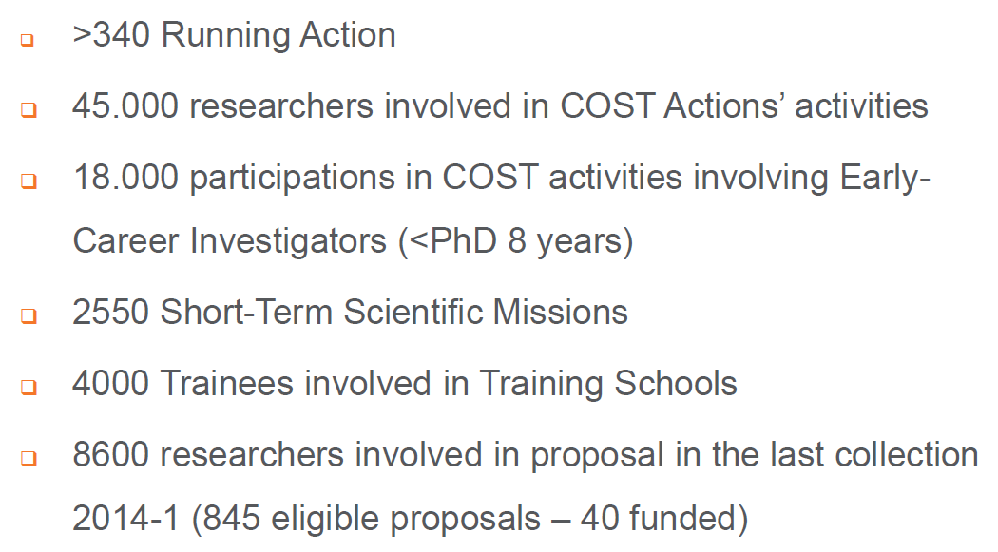

Slide 7
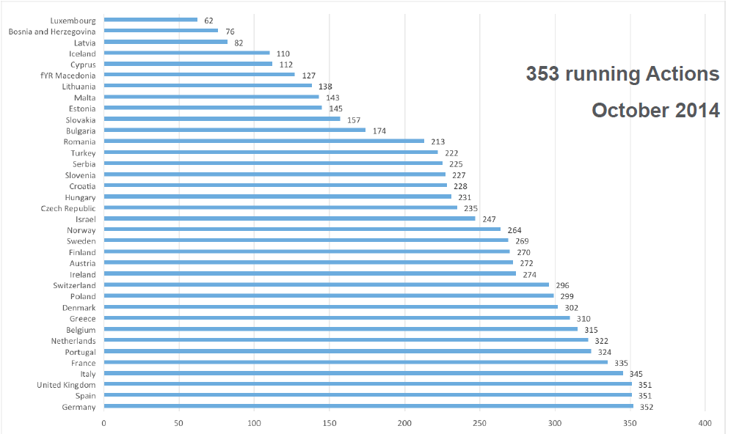

Slide 8
September 2015
In total, 260 submitted proposals were collected on 08 September 2015. In addition, 131 other proposals were registered but not submitted.
These proposals were submitted by proposers based in 33 different COST countries.

Slide 10
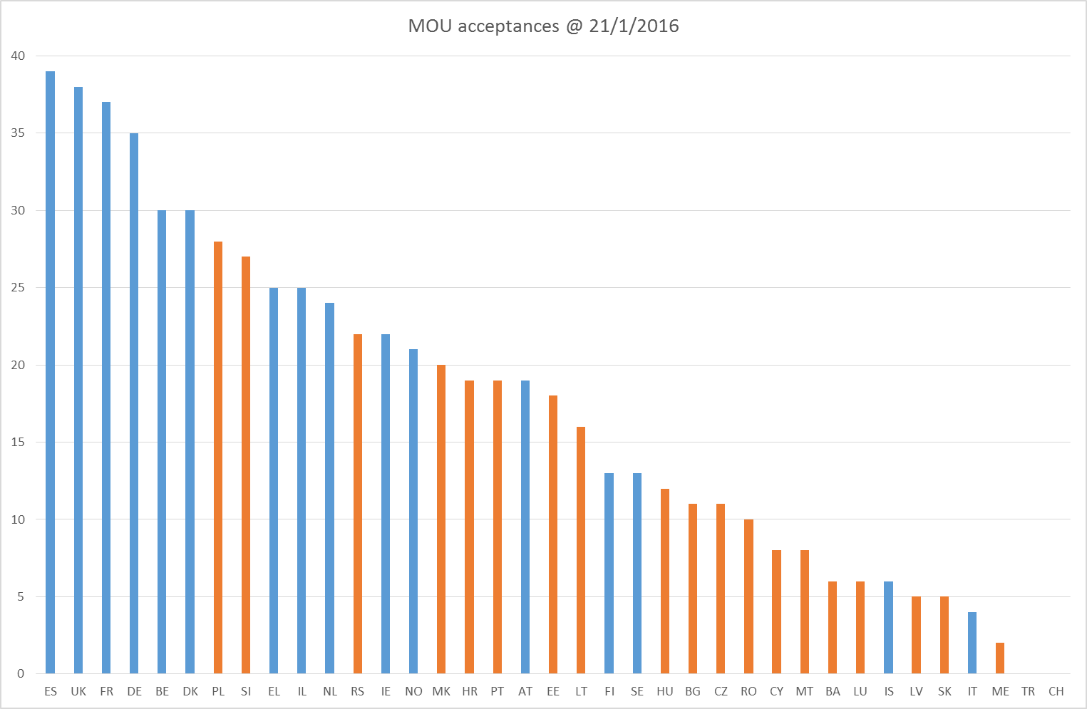
New Action MoU acceptances per COST country

Slide 11
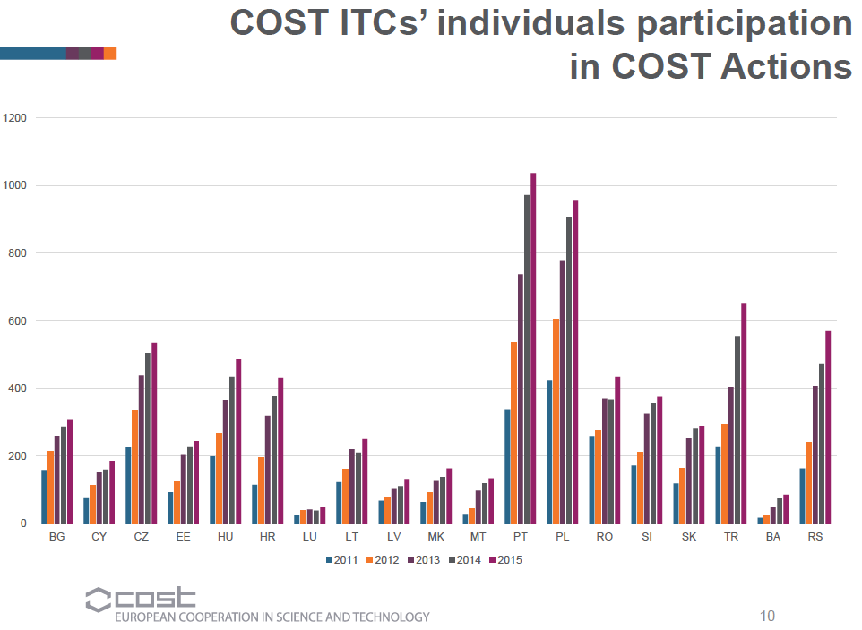

Slide 12
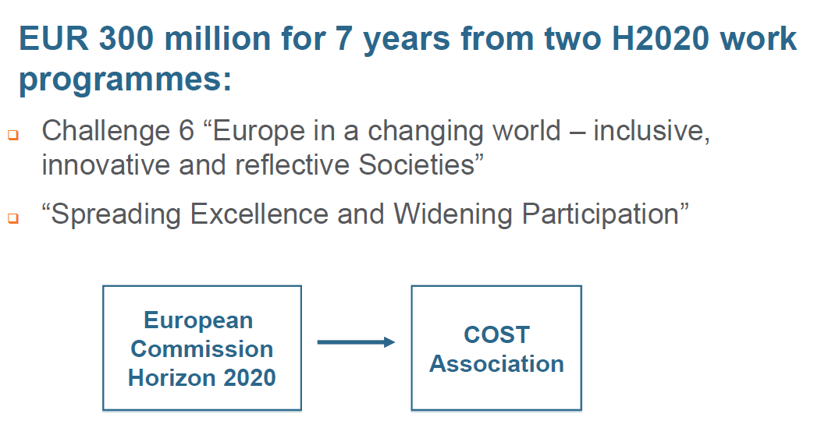

Slide 13
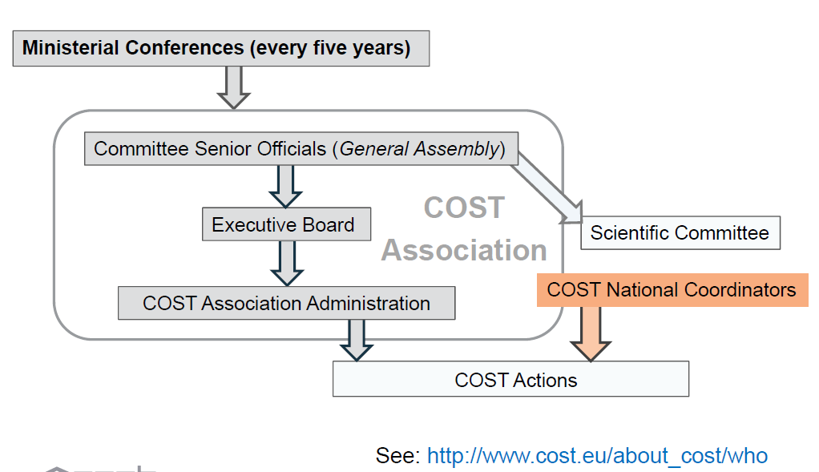

Slide 14
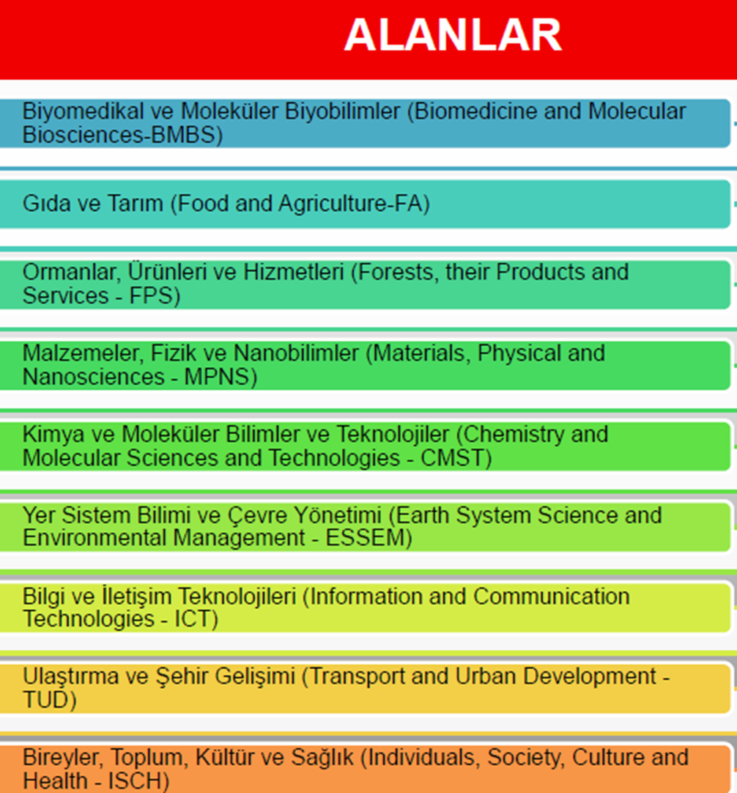

Slide 15
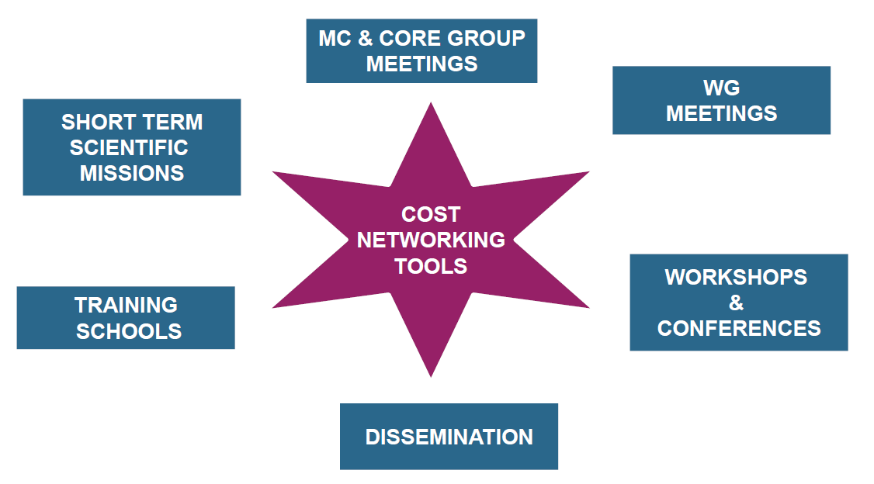
>2550
>4000

Slide 16
Aksiyon Yönetimi?
Aksiyon Yürütme Komitesi
    Her bir aksiyon için Komite
      Her ülkeden 2 MC üyesi
      COST Ulusal Koordinatör tarafından atanma
    EU Komisyondan bir gözlemci
    Diğer organizasyonlardan gözlemciler (SC Committe)
    Aksiyon un koordinasyonu için Danışmanlar
    Ulusal seviyede Bilimsel Koordinasyon
    Bütçe, planlama, sürdürülebilirlik

Slide 17
COST fonlaması
COST aksiyonu ‘Eligible’ aktiviteler:
  Bilimsel MC toplantıları, WG grup toplantıları
  Bilimsel çalıştaylar ve seminerler
  Short Term Scientific Missions (STSMs)
  Training Schools and Research Conferences (!!!)
  Değerlendirme çalışmaları
  Proceedings, Raporlar, broşür, tanıtım vb
  Yayınım, Web sitesi, vb.

Slide 18
Science management meetings & Scientific workshops and seminars
COST covers:
  organisational costs (room rental, meals etc.) ‘workshop support’
  Travel, accommodation and meals of eligible participants
    Rule: max. 2 participants per country per Working Group (WG) and Management Committee (MC)
      Example: COST Action with 15 signatory countries, Management Committee + 4 Working Groups → 150 participants can be reimbursed!
      invited experts

Slide 19
Short Term Scientific Missions
Aim: promote researchers mobility within an Action’s scientific objectives
Means: by allowing a scientist to go to a laboratory in another COST country to learn a new technique or to make measurements using instruments and/or methods not available in their own laboratory
Target group: junior researchers, but also others
Mobility: from one COST country to another within the Action (add. agreements with Australia, New Zealand..)
Duration: between 5 days and 3 months (financial contribution will normally not exceed 2,500 €)

Slide 20
Training Schools and Research Conferences
Aim: dissemination of the scientific and technical results from COST Actions activities and intensive training in a new emerging subject in one of the laboratories of the Action with unique equipment or know how
Means: by supporting the organisation of training schools and conferences
Duration: 3-5 days up to a maximum of 2 weeks,
Lecturers: max. 5, reimbursement under usual COST rules (travel, accommodation, meals)
Students: max. 30 students get some financial support

Slide 21
BÜTÇE (hatırlatma)
Sadece koordinasyon ve ilgili masraflar (toplantı katılım masrafları) COST'un bütçesinden karşılanırken, araştırma faaliyetlerinin bütçesi Ulusal Fonlama Kuruluşları (Türkiye’de TÜBİTAK) tarafından karşılanır.
COST, her ülkeden 2 MC ve 2 WG üyesinin MC ve WG toplantılarına katılım masraflarını karşılamaktadır.
COST aksiyonlarının faaliyetleri (workshops, conference, STSM, Training Schools etc) , AB ÇP tarafından finanse edilmektedir.

Slide 22
COST Aksiyonlarına Katılım
Yeni bir COST Aksiyonu önerisinde bulunmak: “Öneride bulunan” ülkenin yanına en az 4 farklı (Toplam 5) ülkeden araştırmacıları da alarak doğrudan COST’a yaptığı öneri.
Mevcut bir COST Aksiyonuna katılmak: COST’un mevcut 200’den fazla aksiyonundan araştırmacının konusuyla ilgili olan bir tanesi altında yürürlükte olan araştırma projesi kapsamında MC (Management Committee) üyesi olarak atanması.

Slide 23
COST Aksiyonlarına Katılım
COST, ulusal olarak desteklenen araştırma projelerinin (1001, 1003, vb (ARDEB) in onayı) yürütücülerinin, Avrupa düzeyinde oluşturulmuş bilimsel ağlara dahil olmalarını sağlamaktadır.
COST’un ülkemizdeki bilimsel koordinatörlüğü TÜBİTAK UİDB tarafından sağlanmaktadır.

Slide 24
COST Aksiyonlarına Katılım Kuralları
COST Önerisi Sunan: Araştırma projesiz MC üyesi olarak atanabilirsiniz.
Araştırmacıların aksiyonlara katılabilmesi/MC üyesi olarak atanması için:
Aksiyon konusuyla ilgili TÜBİTAK’a araştırma proje önerisi sunulması ve projenin TÜBİTAK’ça desteklenmesi;
Aksiyon konusu ile ilgili TÜBİTAK’ta yürürlükte bir araştırma projesinin olması (2515, 1001, 3501) veya
Aksiyon konusu ile ilgili TÜBİTAK’ta yürüyen bir projenin mevcut olmaması ancak konu ile ilgili bir BAP olması
Aksiyon konusu ile ilgili TÜBİTAK’ta yürüyen bir proje ve üniversitede bir BAP olmaması, ancak önceden projeyle katılım sağlanan bir aksiyonun devamı olması

Slide 25
COST Projesi Önerme ve Destekleme Süreci
www.cost.eu adresli COST web sayfasından araştırmacının kendi konusuyla ilgili bir COST aksiyonunu seçerek MoU’sunu incelemesi
İlgili MoU çerçevesinde COST Proje Öneri Formunun doldurulması
Formlar için erişim: www.tubitak.gov.tr/uidb/cost
Formların TÜBİTAK UİDB-’e teslim edilmesi
Proje önerisinin ARDEB/Araştırma Gruplarında değerlendirilmesi (yaklaşık 3 ay)
Desteklenen projenin yürütücüsünün MC temsilcisi olarak atanması

Slide 26
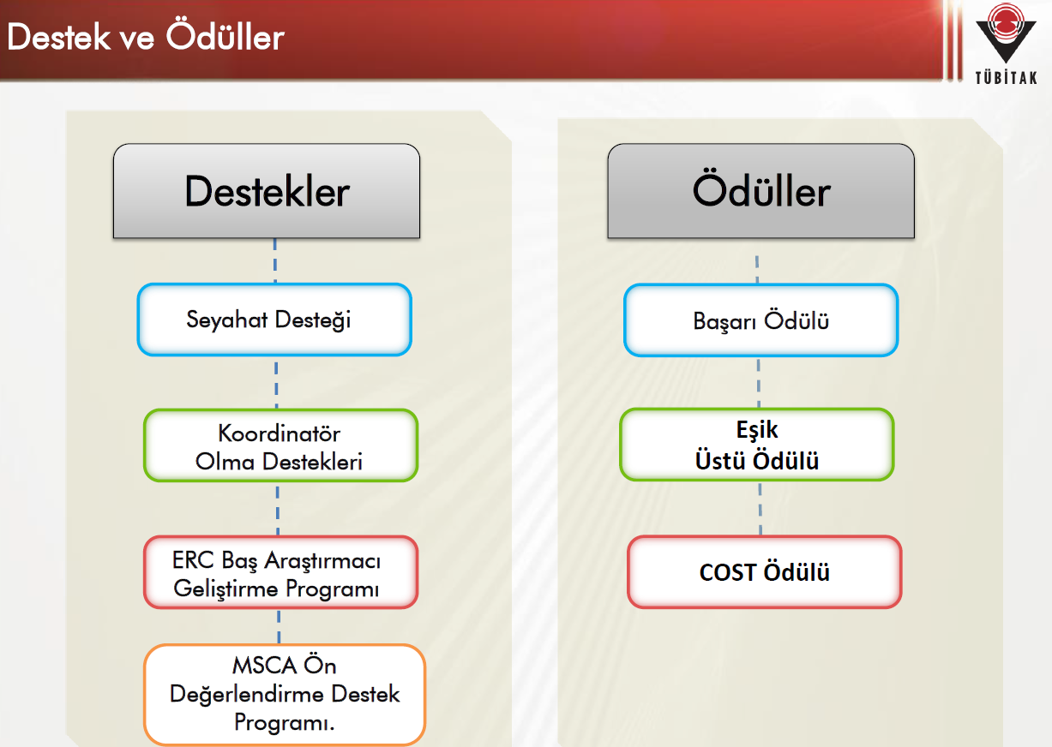

Slide 27
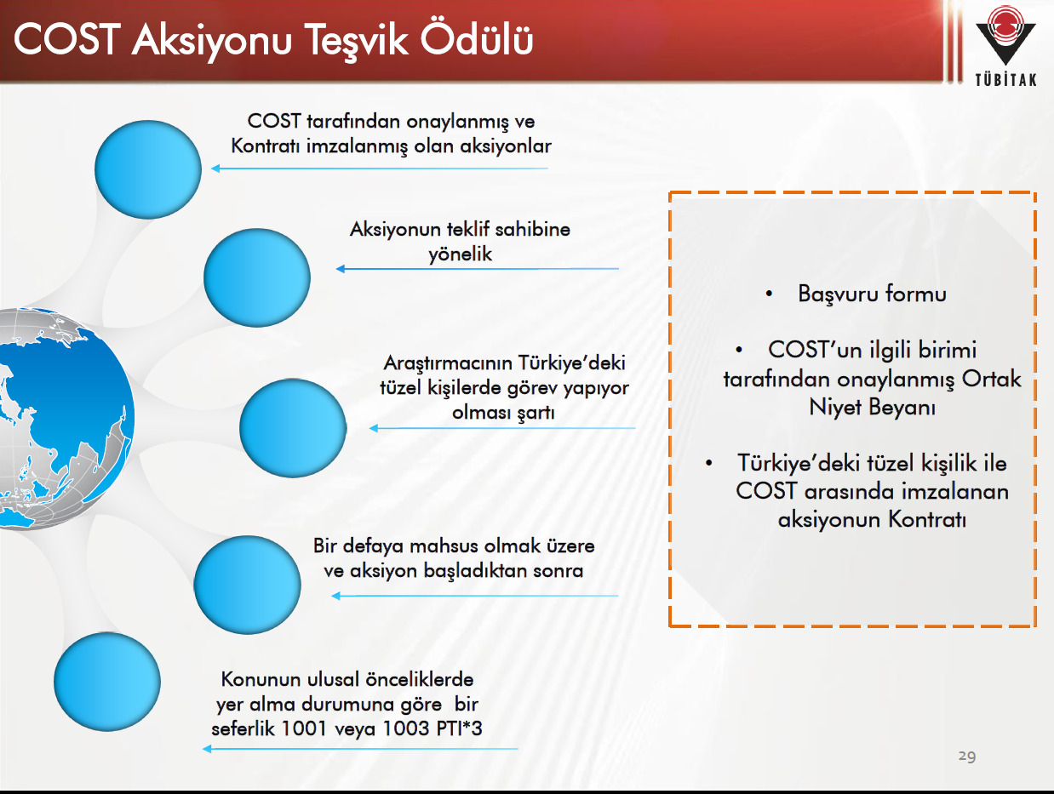

Slide 28
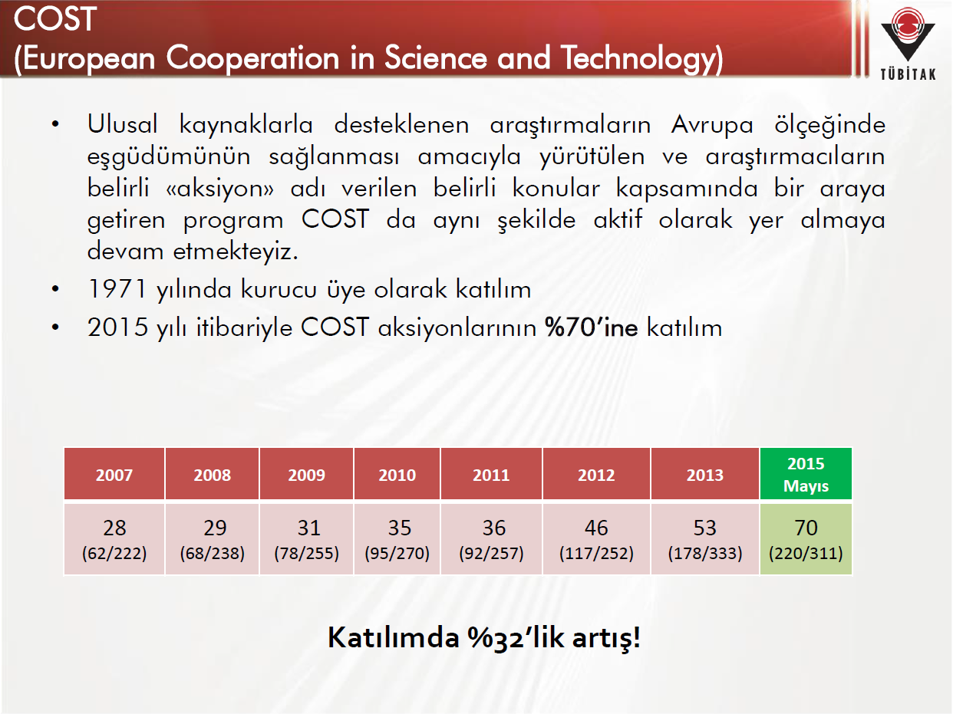

Slide 29
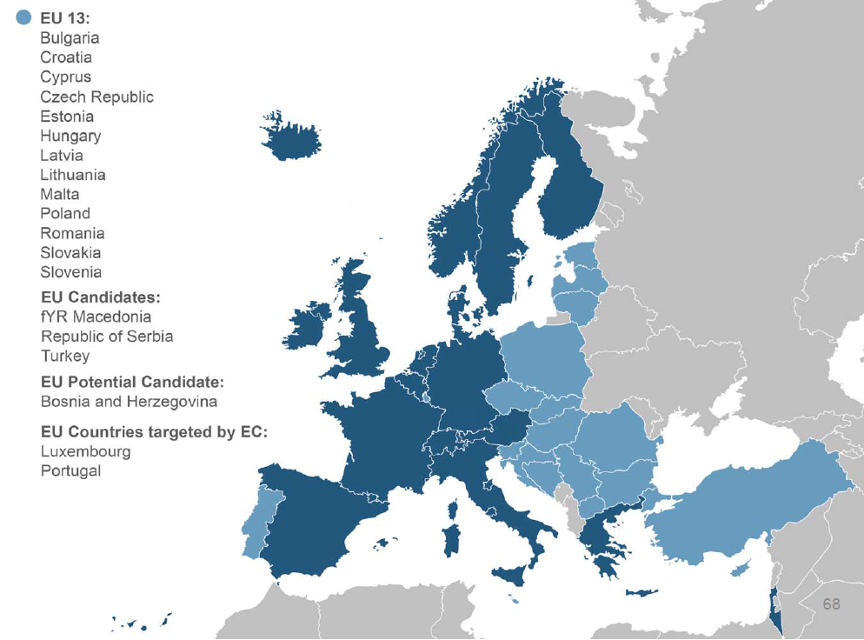

Slide 31
Yeni COST Aksiyonları için Çağrı
(Open Call) Sistemi
Yılda iki kez yapılan iki aşamalı çağrı (open call)
Ön başvuruların COST tarafından yapılan değerlendirmesi
En yüksek puanı alan 75 öneri sahibine “tam teklif” (full proposal) için davet
Tam tekliflerin oluşturulan panellerde değerlendirilmesi ve onaylanması

Slide 32
Proposal template
Proposals for COST Actions have the following sections:
• General Features
• Technical Annex
• References
• COST Mission and Policies
• Network of Proposers
All these sections are to be completed online with the exception of the Technical Annex. The instructions related to each section are specified below.

Slide 33
GENERAL FEATURES
Open Call number; Automatically assigned
Proposal reference ; Automatically assigned
Title; Mandatory, Max. 12 words
▪ The title of the proposal should describe at a glance what the proposal is about
Acronym ; Mandatory
Summary; Max. 250 words; illustrate the challenges, Action is proposing to address.
Be brief, clear and “to the point”: illustrate your ideas in a concise manner. Explain what is the main S&T and/or societal Challenge the proposed Action aims to address.
Key expertise needed for evaluation ; min. 1, max. 5 (recommended: 3)
Be aware that this will be the key information for the identification of external experts. COST Association will identify Independent External Experts that have this expertise and are appropriate for the evaluation of your proposal.
Keywords ; Minimum 3 and maximum 5 keywords (not exceeding 60 characters)
▪

Slide 34
Section 1 - S&T EXCELLENCE
1.1 Challenge
1.1.1 Description of the Challenge (Main Aim)
1.1.2 Relevance and timeliness
Describe the research question(s) your proposal aims to address. You should make a case for the relevance and timeliness of the proposed challenge(s).
1.2 Objectives
1.2.1 Research Coordination Objectives
1.2.2 Capacity-building Objectives
Provide a clear and specific description of the project objectives against the background of the state-of the-art, showing their pertinence to tackle the proposed challenge. Make sure the proposed objectives are SMART (Specific, Measurable, Achievable, Relevant and Timely).
1.3 Progress beyond the state-of-the-art and Innovation Potential
1.3.1 Description of the state-of-the-art
1.3.2 Progress beyond the state-of-the-art
1.3.3 Innovation in tackling the challenge

Slide 35
1.3 Progress beyond the state-of-the-art and Innovation Potential (Cont.)
Describe briefly the state-of-the art in the field related to the challenge, as well as the advance that the COST Action will bring about.
Highlight the innovation potential anticipated by the proposed COST Action in order to tackle the challenge. Innovation is to be intended as the creation and / or development of new or improved concepts, products, processes, services, and / or technologies that are made available to markets, governments and society.
1.4 Added value of networking
1.4.1 In relation to the Challenge
1.4.2 In relation to existing efforts at European and/or international level
Describe the added value of networking in relation to the challenge by highlighting why networking is the best approach to tackle the challenge.
Describe the added value of the proposed COST Action in relation to former and existing efforts (research projects, other networks, etc.) at the European and/or international level.

Slide 36
Section 2 - IMPACT
2.1 Expected Impact
2.1.1 Short-term and long-term scientific, technological, and/or socio-economic impacts
Describe in a clear and realistic way the S&T and socio-economic impact envisaged by the proposed COST Action in the short- and long-term perspective.
2.2 Measures to Maximise Impact
2.2.1 Plan for involving the most relevant stakeholders
Identify the most relevant stakeholders and present a clear plan to involve them as Action’s participants.
2.2.2 Dissemination and/or Exploitation Plan
Present a clear and attainable plan for dissemination and/or exploitation of results, including IPR, if relevant13.
2.3 Potential for Innovation versus Risk Level
Make a case on how well the proposal succeeds in putting forward potential innovation/ breakthroughs with a convincing risk/return trade-off.

Slide 37
Section 3 - IMPLEMENTATION
3.1 Description of the Work Plan
3.1.1 Description of Working Groups
Provide a detailed description of the different Working Groups. For each WG provide objectives, tasks, activities, milestones and list of major deliverables.
3.1.2 GANTT Diagram
3.1.3 PERT (optional)
3.1.4 Risk and Contingency Plans
3.2 Management structures and procedures
3.3 Network as a whole
3.4.3 References

Slide 38
3.4.4 COST Mission and Policies
This section must be completed online and shall summarize how the proposal, if funded, would respond to COST Mission and Policies.
COST Mission and Policies
▪ Mandatory section
▪ Max. 500 words
▪ Free text section to allow the proposer to show how the proposed Action will contribute to address one or more of the COST Policies. The proposer should list relevant activities planned in the proposal pointing out which COST Policy they target and how.
▪ An example for COST Excellence and Inclusiveness Policy addressing ITC:
- Leadership roles in COST Actions
- Grant Holder role
▪ The content of this section will be taken into account during the selection phase conducted by COST Scientific Committee.
3.4.5 Network of Proposers

Slide 39
3.6 Definition of key concepts to help the preparation of proposals
3.6.1 Challenges of COST Actions
Challenges are the research questions addressed by a COST Action, targeting S&T and / or socio-economic problems.
In COST Actions, researchers, engineers and scholars from different places and backgrounds are expected to work as a team towards the resolution of a S&T challenge. To respond to the challenge, the network needs not only coordination in working as a team, but also in gathering a critical mass of researchers around the science and technology topic in question.
3.6.2 Potential innovation/breakthrough of COST Actions
Through the Actions, COST aims at enabling breakthrough scientific developments leading to new concepts and products and thereby contributing to strengthening Europe’s research and innovation capacities.
When choosing a COST Action as an instrument to tackle the S&T Challenge, researchers must have a clear vision on the innovation potential of their endeavour.

Slide 40
3.6.3 Objectives in COST Actions
COST Action objectives are the results that an Action needs to achieve in order to respond to its challenge. These are SMART (Specific, Measurable, Achievable, Relevant, Timely) and twofold: Research Coordination Objectives and Capacity-building Objectives, in order to comply with COST Mission.
a. Research Coordination Objectives
These objectives entail the distribution of tasks, sharing of knowledge and know-how, and the creation of synergies among Action participants to achieve specific outputs. Achieving these objectives turns COST Actions from initially scattered groups into one transnational team and leverages the existing funded research.
b. Capacity-building Objectives
Achieving these objectives entail building critical mass to drive scientific progress, thereby strengthening the European Research Area. They can be achieved by the delivery of specific outputs and/or through network features or types and levels of participation.

Slide 41
3.6.4 COST Action Strategy and Structure
▪ S&T research and development activities necessary to achieve the objectives;
▪ The internal organisation, and other managing structures needed
▪ The work plan and networking tools – meetings (MC and meetings, workshops, conferences), STSM, Training Schools and Dissemination activities to share ideas and knowledge and create added value;
▪ The timeline for the implementation
3.6.5 COST Networking tools
▪ Meetings (MC and WGs meetings, Workshops, Conferences),
▪ Training Schools,
▪ Short-Term Scientific Missions (STSMs),
▪ Dissemination.
3.6.6 COST Action activities
All the activities organised by the COST Action, by means of the networking tools, in order to achieve the research coordination and capacity-building objectives.
3.6.7 COST Action results and outputs
These are the direct results stemming from the COST Action activities, codified knowledge, tacit knowledge, technology, and societal applications:

Slide 42
3.6.8 COST Action impact
Impact is the effect or influence on short-term to long-term scientific, technological, and/or socio-economic changes produced by a COST Action, directly or indirectly, intended or unintended.
3.6.9 COST Action deliverables
Deliverables are distinct, expected and tangible outputs of the Action, meaningful in terms of the Action’s overall objectives, such as: reports, documents, technical diagrams, scientific and technical papers and contributions, content for training schools, input to standards, best practices, white papers, etc. Action deliverables are used to measure the Action progress and success.
3.6.10 COST Action milestones
Milestones are control points in the Action that help to map progress. They can be Core Group or MC meetings, mid-term reviews etc. They are needed at intermediary stages so that, if problems have arisen, corrective measures can be taken.

Slide 43
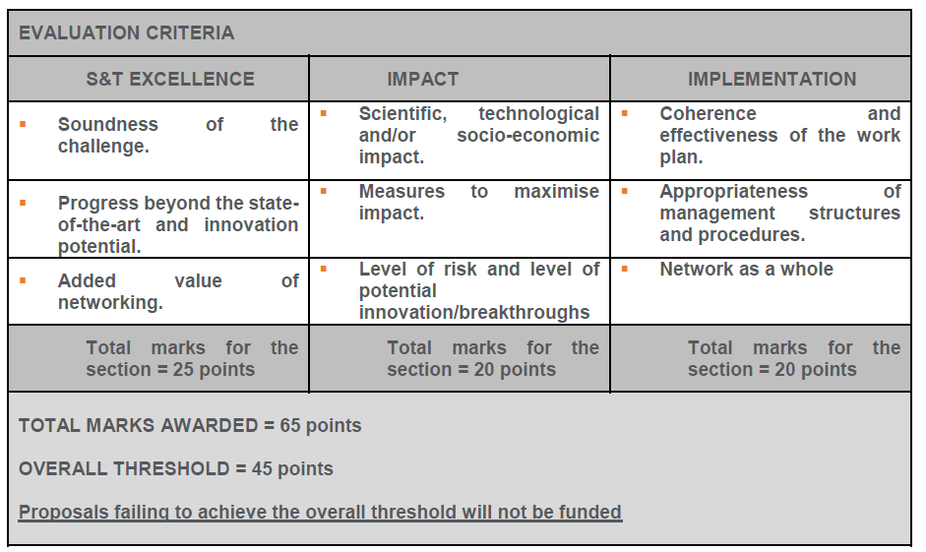

Slide 44
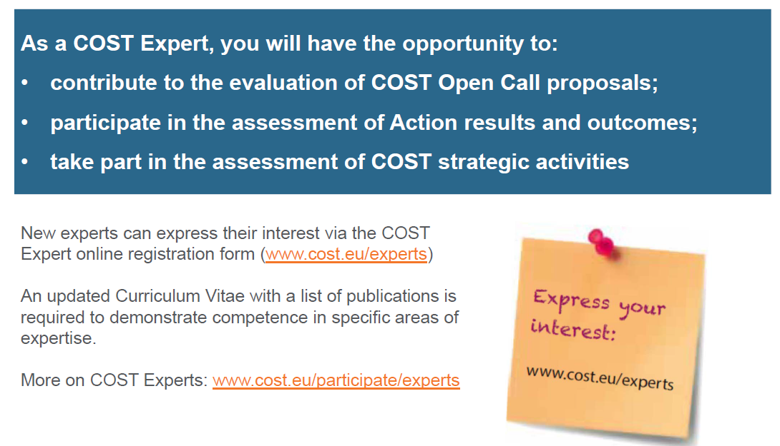

Slide 45
NMP-COST İşbirlikleri (Cluster)
COST MP1106 " Smart and green interfaces - from single bubbles and drops to industrial, environmental and biomedical applications (SGI)" Core Group Member, STSM Coordinator, (2012-2015)
Setup of clusters gathering people from the action in view of Horizons 2020
Knowledge and Innovation Communities
http://eit.europa.eu/kics/
European Innovation Partnerships
http://ec.europa.eu/research/innovation-union
Application focused

Slide 46
COST MP1106, Core grup olarak, COST amaç ve hedefleri kapsamında,
Round Tables (RT) were organized concerning the topics:
1) Food, Biotechnology and Biomedical
2) Energy and Environment
3) Nanotechnology and Nanoscience
RTs, 3 ana grup altında, alt çalışma grupları seçmek amacıyla,
Knowledge-Innovation Communities (KIC);
European Innovation Partnerships (EIP) vb, girişimler ile ilgili bilgilendirme
HORIZON 2020 programı konusunda bilgilendirme;
Sanayi ve akademinin çalışma ilgi alanlarının belirlenmesi
Çalışma alanları akademik koordinatörler tarafından raporlandırıldı
MC üyeleri arasında, her bir MC üyesi ve katılımcılar arasında gruplar oluşturuldu

Slide 47
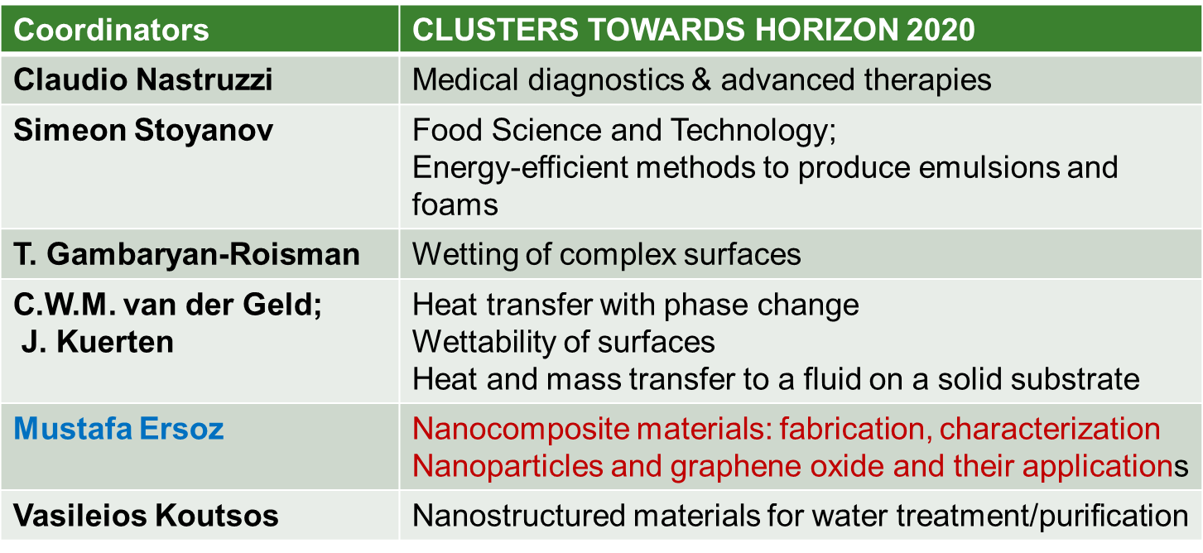
COST MP1106, MC toplantısında;
EC, DG Research den, bir uzman, Horizon 2020 programı konusunda geniş bir bilgilendirme
Tema koordinatörleri tarafından, çalışma alanlarının revize edilmesi

Slide 48
Coordinatörlerin görevleri;
Horizon 2020 çağrıları konusunda, grup üyelerini sürekli bilgilendirmek;
Cluster alanına göre, ilgili çağrı konularını tespit etmek
MC toplantılarında, Cluster toplantısı, proje fikirlerinin tartışılması
Grup üyeleri arasında çağrı konusu hakkında bilgi toplamak
Role | Contribution | Resources to be committed | Propose industrial partner Colloboration/identification
Idea | Products | TRLs | Current knowledge | Innovation (S&T)
Bütçe (Toplantı organizasyonu, 25.000 €)
Konsorsiyum oluşturma amacıyla toplantı organize etmek
Çağrı konusunda proje fikri olan kişileri toplantıya davet etmek
Toplantıda Proje fikirlerinin tartışılması,

Slide 49
Öneriler doğrultusunda gelişmeler;
COST taki Cluster benzer yapı;
NMP Challenges kapsamında 4 iletişim grubu oluşturulması,
  Bridging the gap between nanotechnology research and markets
  Nanotechnology and Advanced Materials as enablers of applications in Health
  Nanotechnology and Advanced Materials for low carbon energy techn., and Energy Efficiency
  Manufacturing and Sustainable Process Industries
TÜBİTAK NMP tarafından koordine edilmesi
Çağrı yayınlanınca, akademi ve sanayi den katılımcılar ile birlikte proje fikirleri
Proje konsorsiyumları oluşturulması

Slide 50
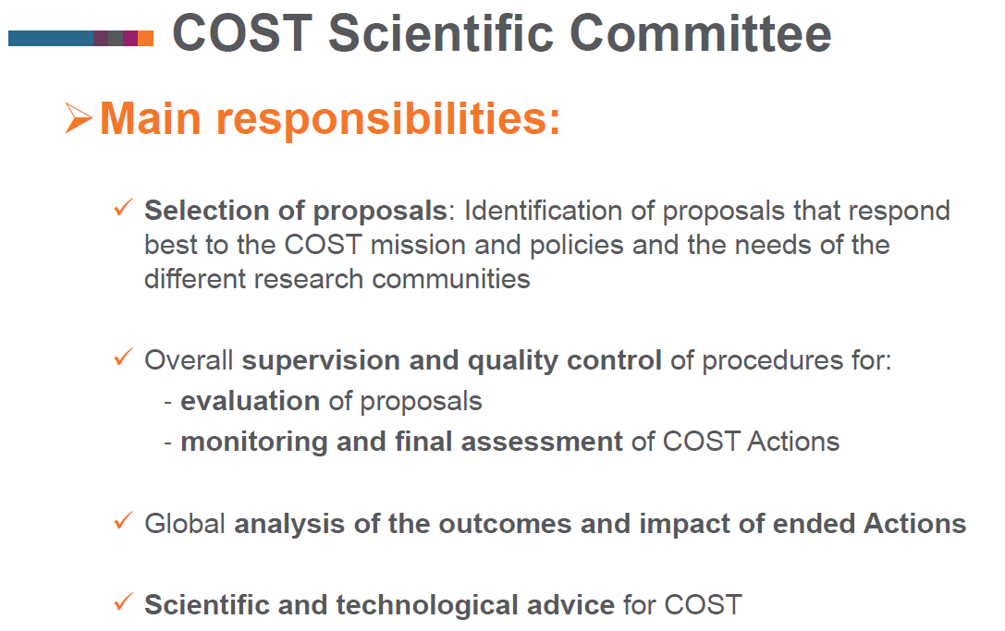

Slide 51

Öneriler;
Avrupalı araştırmacılar arasında etkileşim ve işbirliğini geliştirmenin anahtarı, Bilimsel networking, projelerine mutlaka girilmelidir
Bilimsel işbirlikte en uzun, devam eden, ERA oluşturan program
EU & ötesi, (H2020 ‘Cooperation’); uluslar arası organizasyonlar ve Ar-Ge Merkezleri, non-COST Countries (i.e. USA, Russia, Australia, New Zealand, India…)
İşbirliğimiz,
COST D43 “Colloid and Interface Chemistry for Nanotechnology”, MC üyesi, (FP7-LAMAND)
COST 637 “Metals and Related Substances in Dirinking Water”, WG3 Başkanı, Core grup Üyesi, MC üyesi (FP7-ChitoClean)
COST D36 “Structure-performance relationships at the surface of functional materials”, “Molecular Catalysis and Photocatalysis at Soft Interfaces: Towards chemical fuel cells” WG Üyesi (Marie-Curie-ITN)
COST-MP1202 “Rational design of hybrid organic-inorganic interfaces: the next step towards advanced functional materials

Slide 52


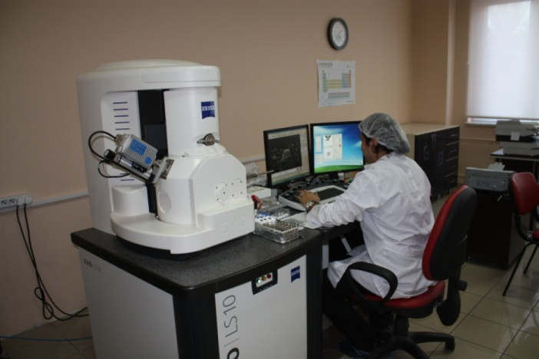
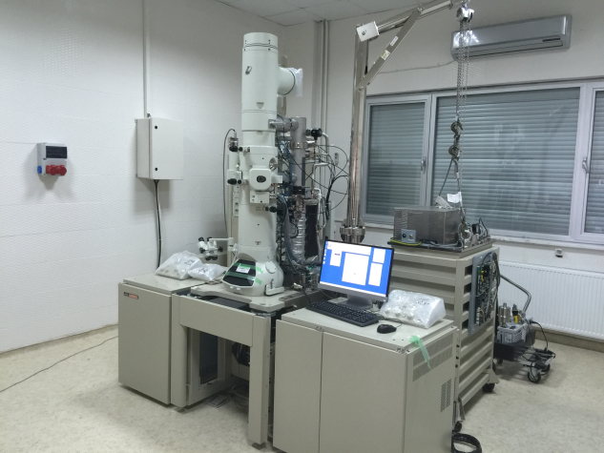
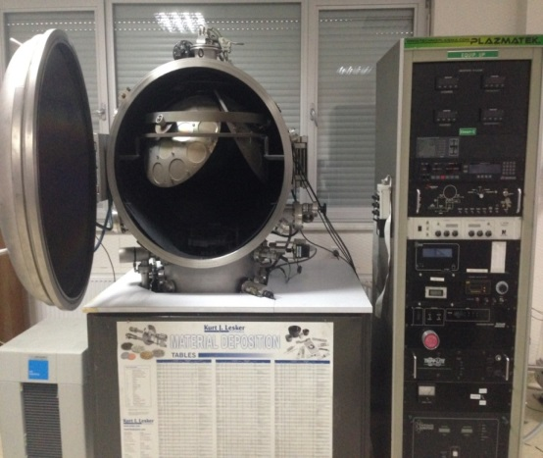
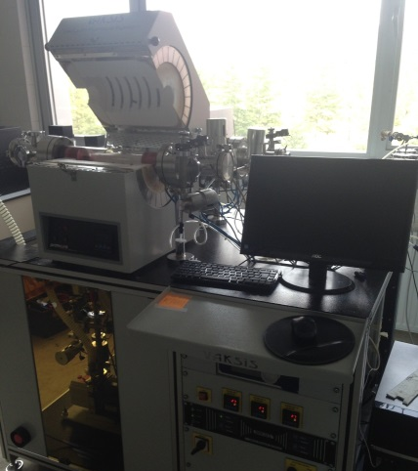
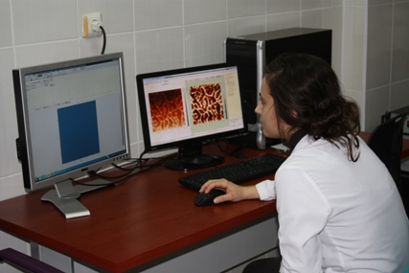
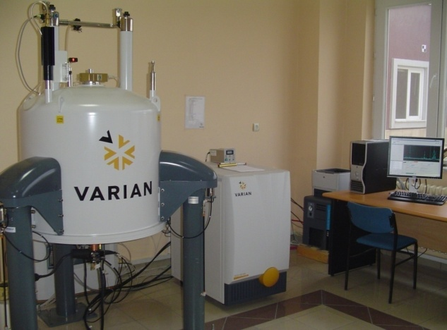
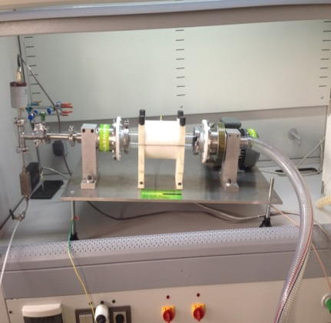
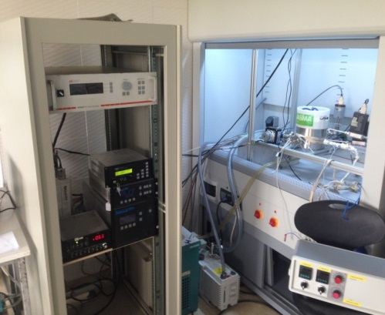
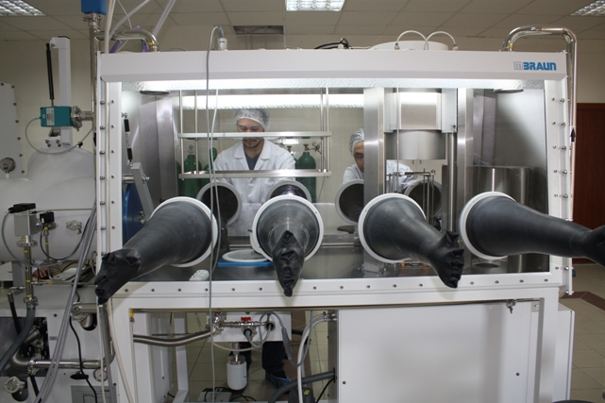
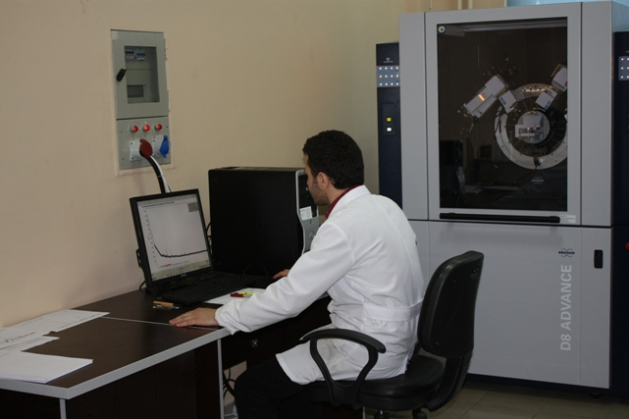
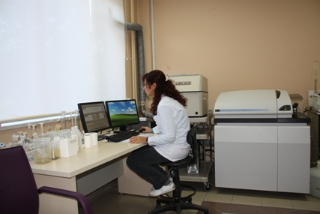
Material Technologies facilities,

Slide 53
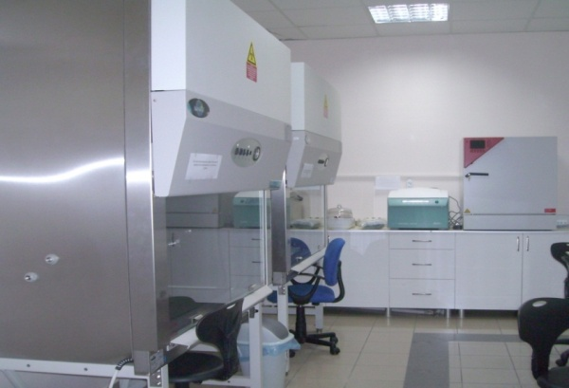
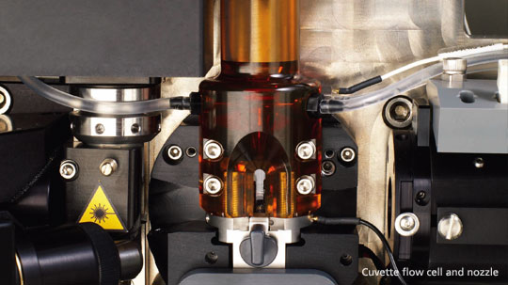
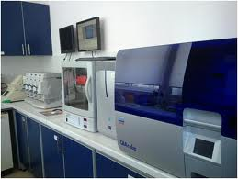
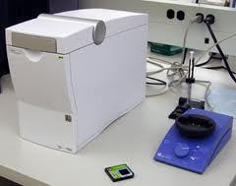
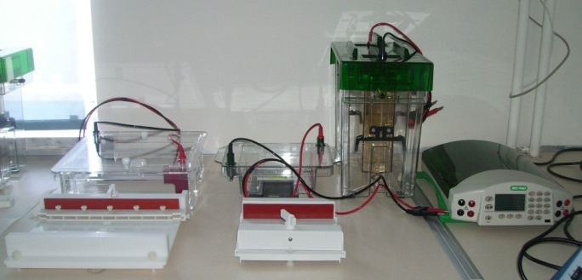
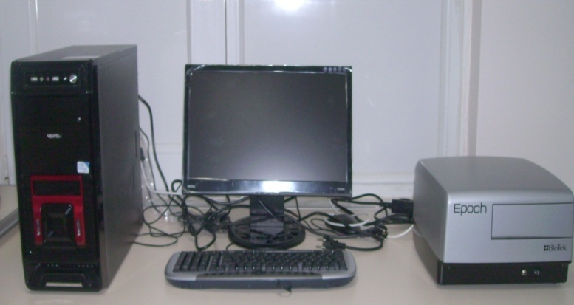
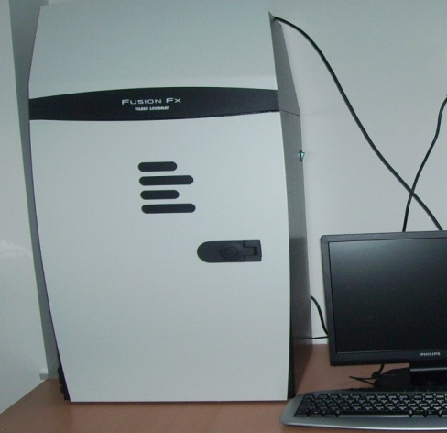
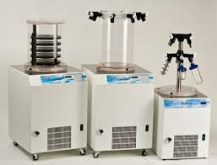
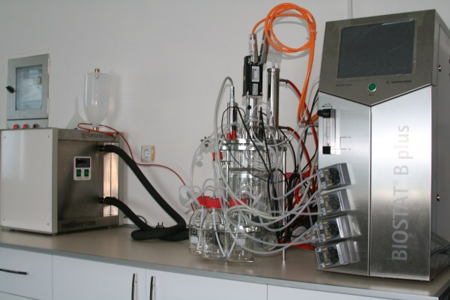
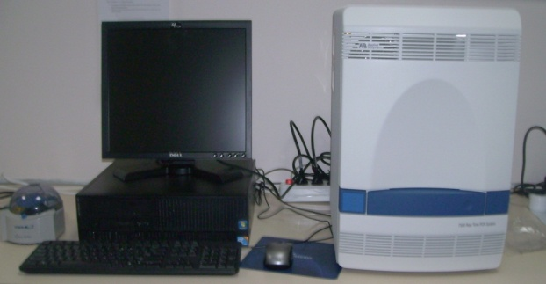
Research (Biotechnology) facilities,

Slide 54
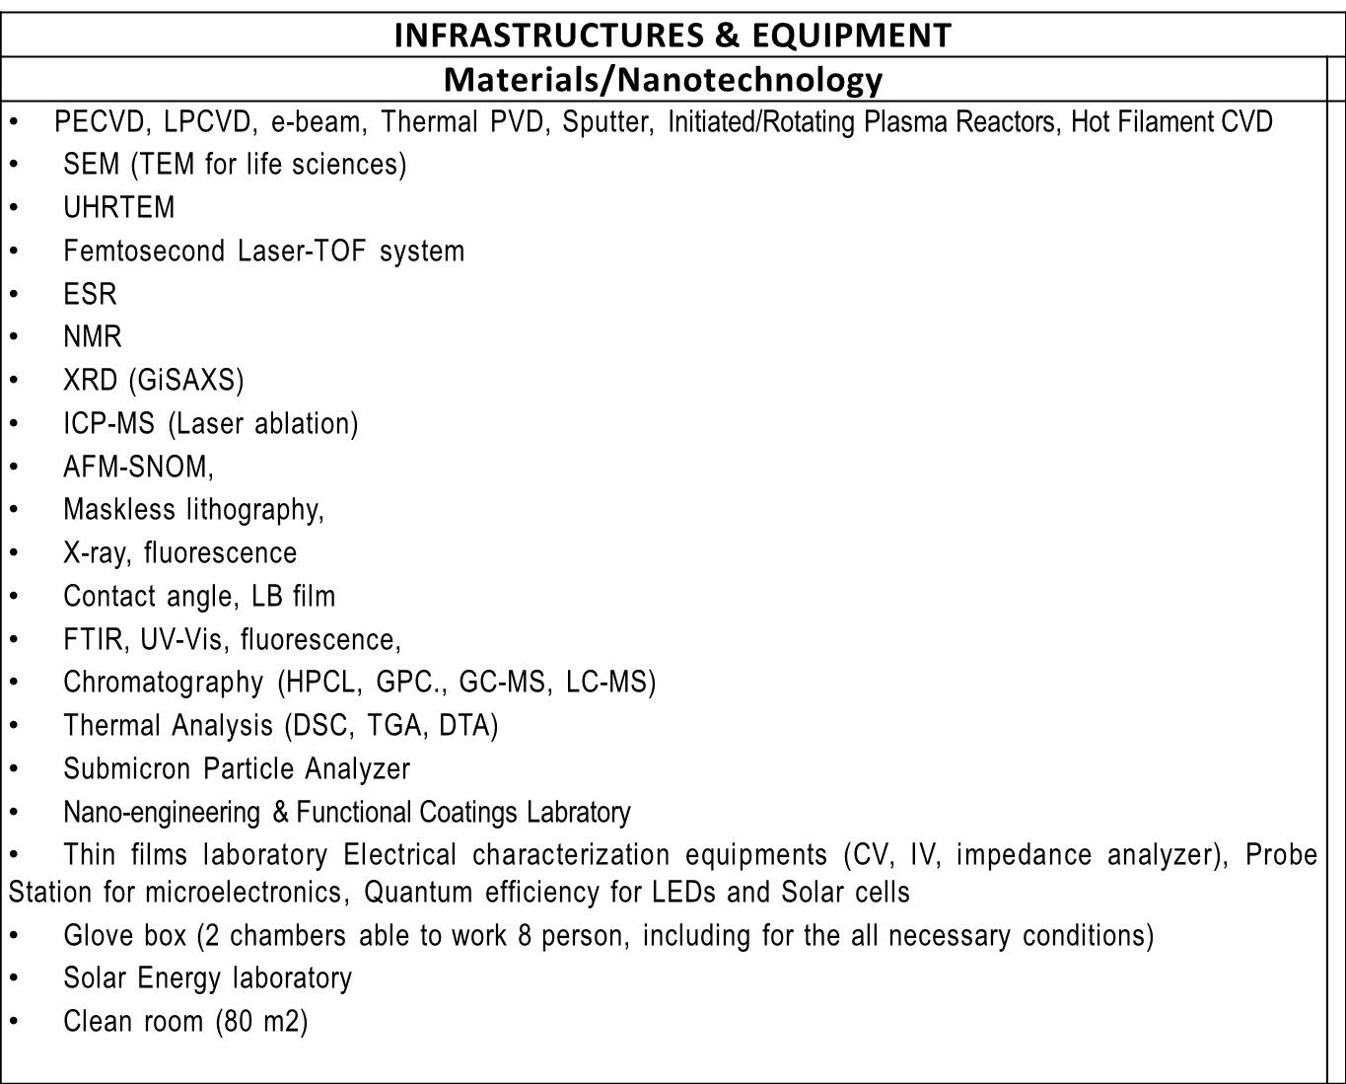

Slide 55
INFRASTRUCTURES & EQUIPMENT
 | Biotechnology
 | Cell culture facilities (Real-time cell analysis system, sterile cabinet, incubators, microscopes, ELISA reader, centrifuge etc.) Molecular genetics laboratory (Microarray system, RT-PCR, bioanalyzer, nanodrop) Bioactive compound preparation laboratory (ultrasonicator, homogenizator, freeze dryer, vacuum centrifuge, ultrasantrifuge) Fluorescent technology (Flow cytometer/ cell sorter, Confocal microscope,fluorescent spectrophotometer, fluorescent microscope) Microbial biotechnology laboratory (5L bioreactor, sterile cabin, incubators, shakers, centrifuge etc.) Plant Biotechnology laboratory (Plant conditioning cabinet, sterile cabinet..)

Slide 56
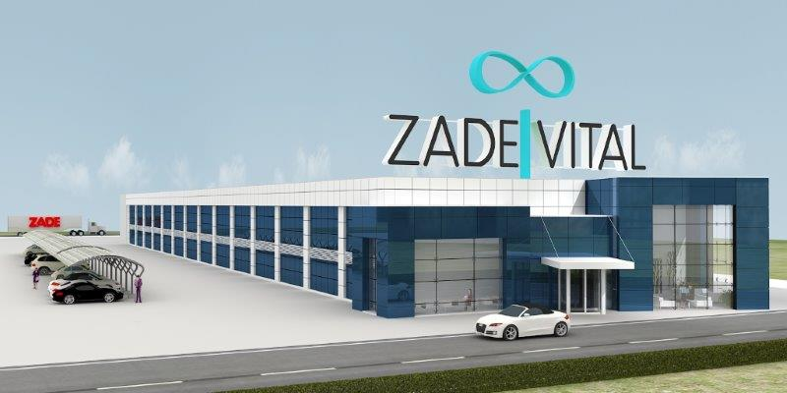
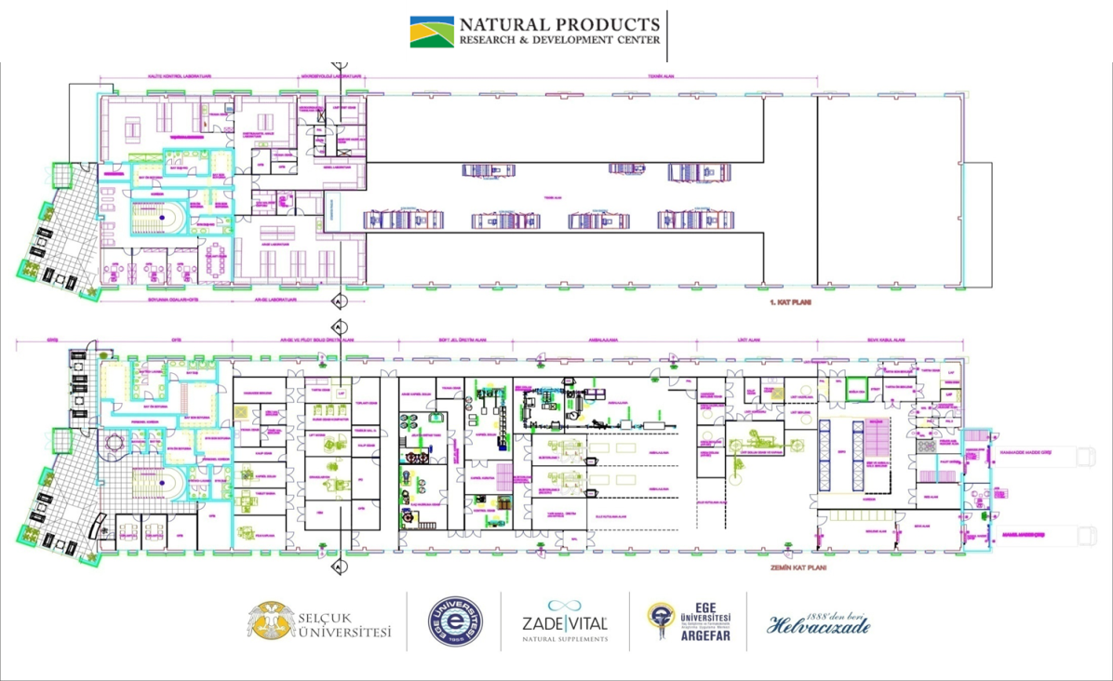
Doğal Ürünler Uygulama ve Araştırma Merkezi
FDA, EP, GMP Standars
Clean rooms
Soft gelatin capsules production
Blistering, Filling, Bottling line
Liquid, solid production
Hard capsules

Slide 57
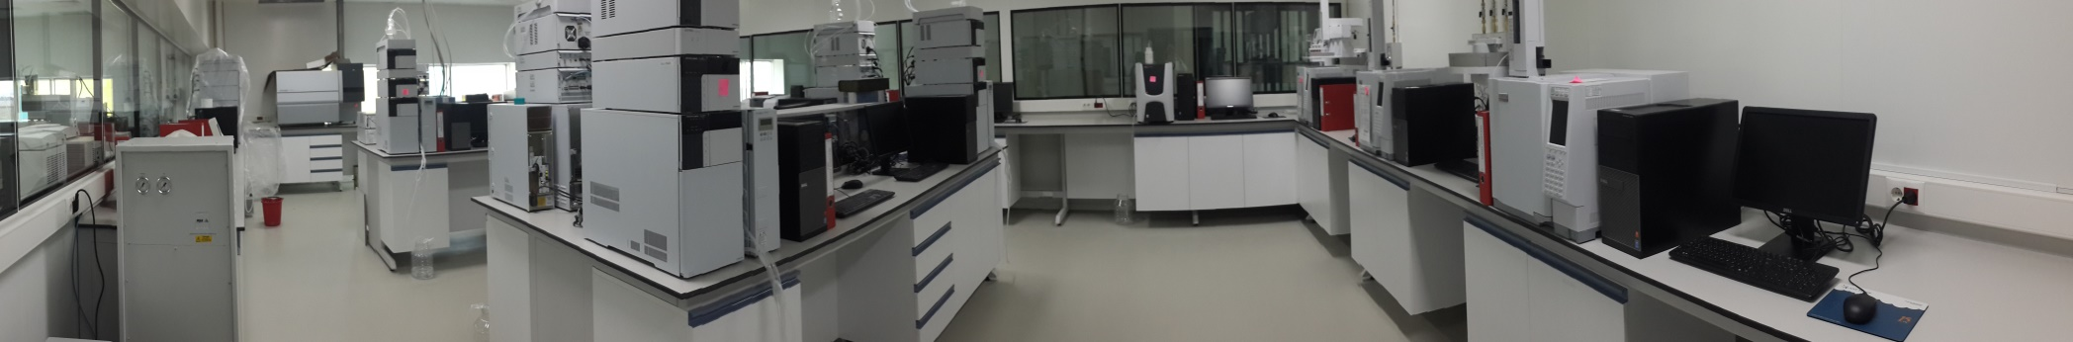
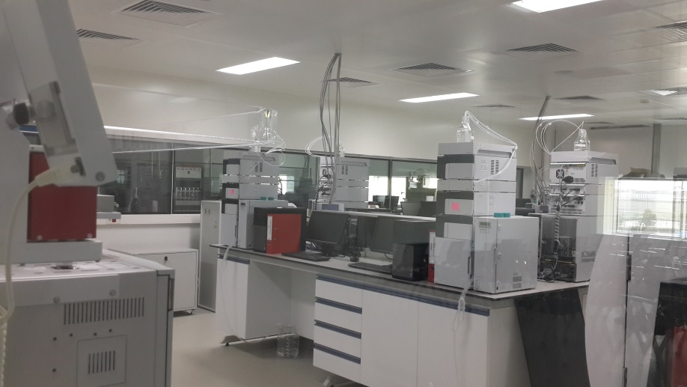
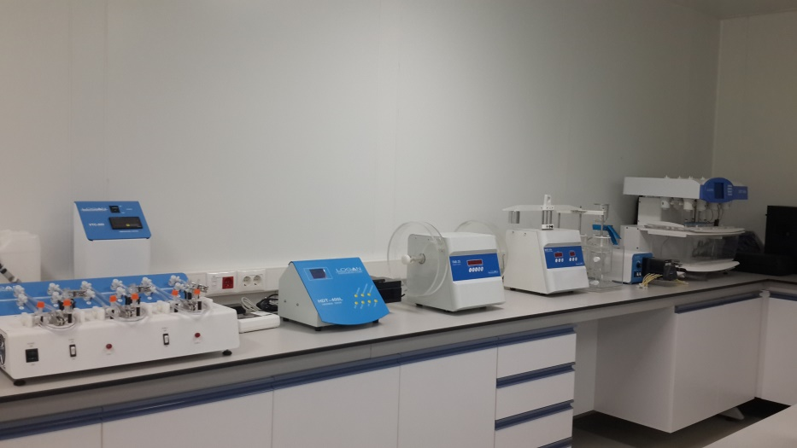
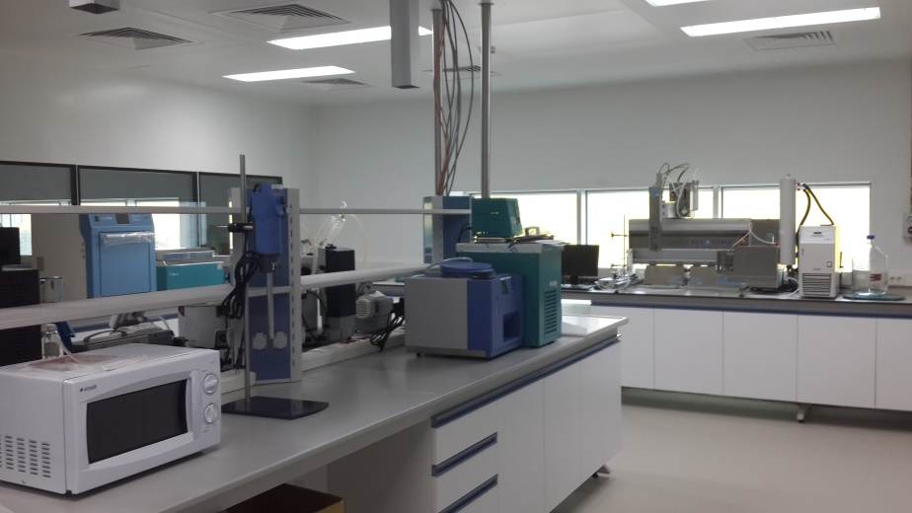
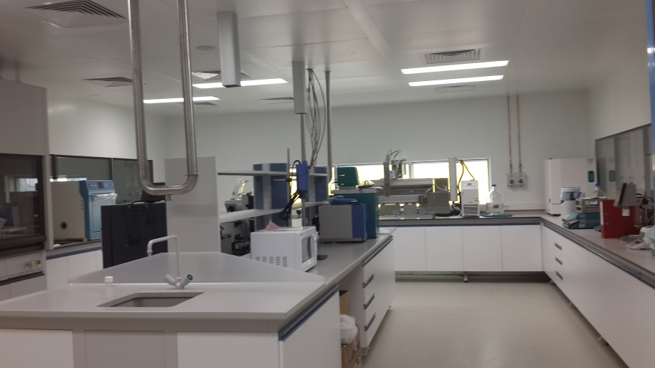

Slide 58
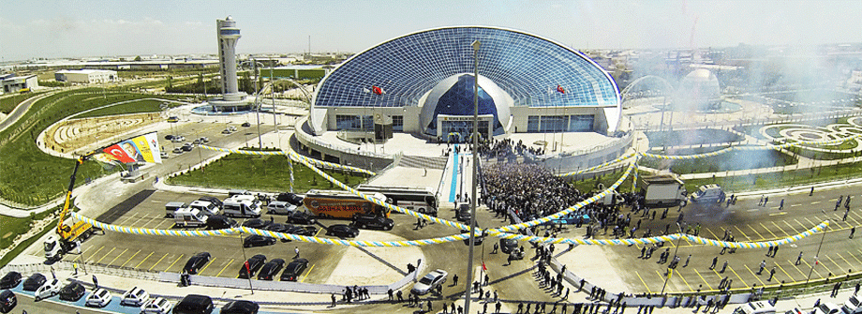
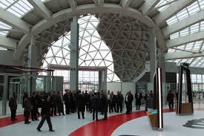

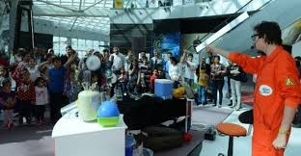
http://www.kbm.org.tr/

Slide 59
